Slide 1
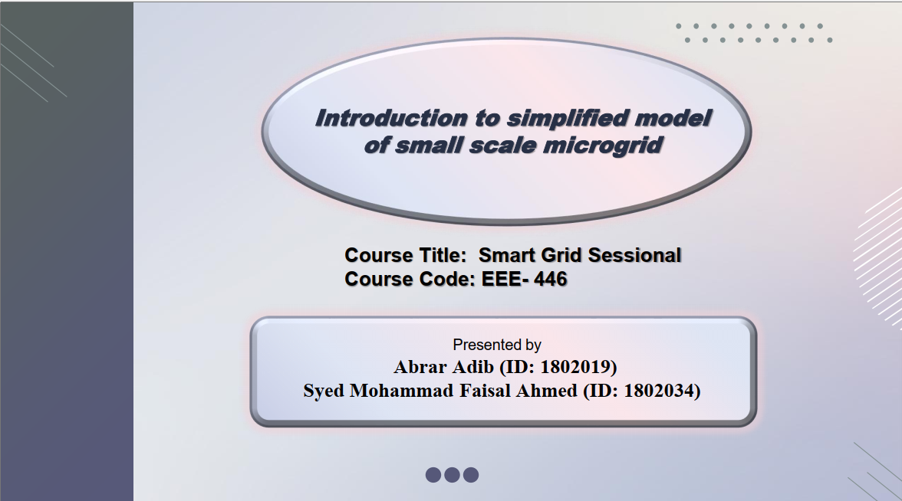

Slide 2
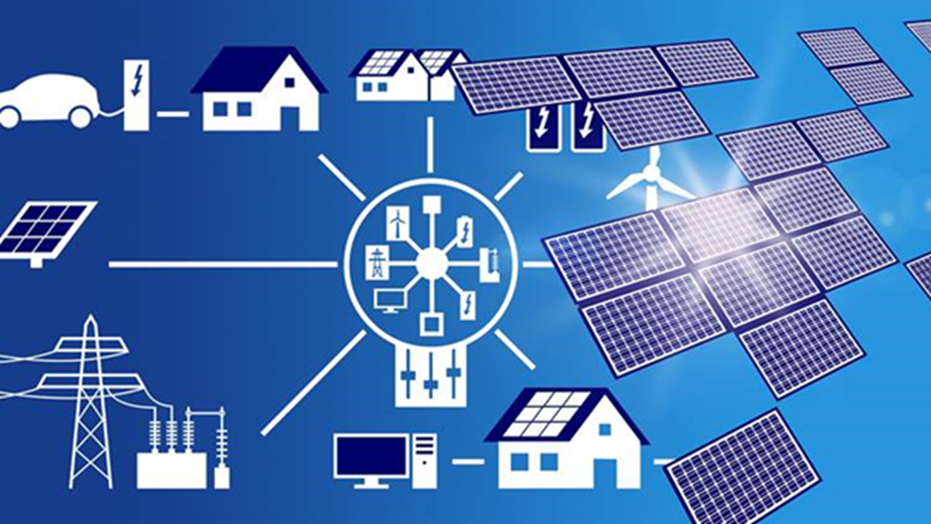

What is a small-scale Microgrid?
It is a small-sized power supply network that is designed to provide power for a small community.
It enables local power generation for local loads.
Microgrids can incorporate battery systems to store electricity and deploy it during outages or when grid demand spikes.
It is connected to both the local generating units and the utility grid thus preventing power outages.
Introduction

Slide 3
List of contents
Introduction to microgrid
Operating modes.
Necessity & Challenges
Simulink model of small scale microgrid
Simulation result and analysis
Conclusion
Introduction

Slide 4
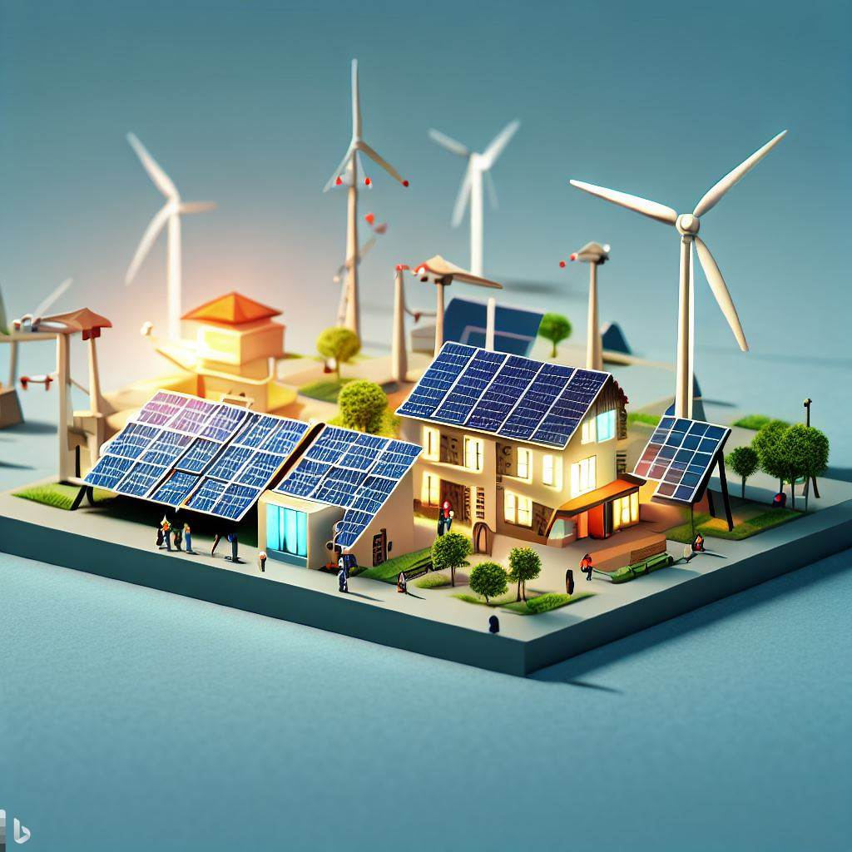
How microgrid generates electricity?
Fuel-based generators.
Solar power.
Wind power.
Energy storage system.
Introduction

Slide 5
Operating modes of microgrid
Grid-connected mode: In this mode, the microgrid is connected to the main power grid.
Islanded mode: the microgrid operates independently from the main power grid.
Transition mode:
The transition mode involves seamless switching between Islanded and Grid- connected mode ensuring a smooth and stable power supply.
Introduction

Slide 6
The Necessity of microgrid
Microgrid could be the answer to our energy crisis.
Transmission loss gets significantly reduced.
Electrification of Remote Areas.
Less emission of greenhouse gases.
Encourages the use of renewable energies.
Introduction

Slide 7
The Challenges of microgrid
Initial Capital Costs
Technical Complexity
Maintenance and Operation
Limited Energy Capacity
Unpredictable weather patterns
Introduction

Slide 8
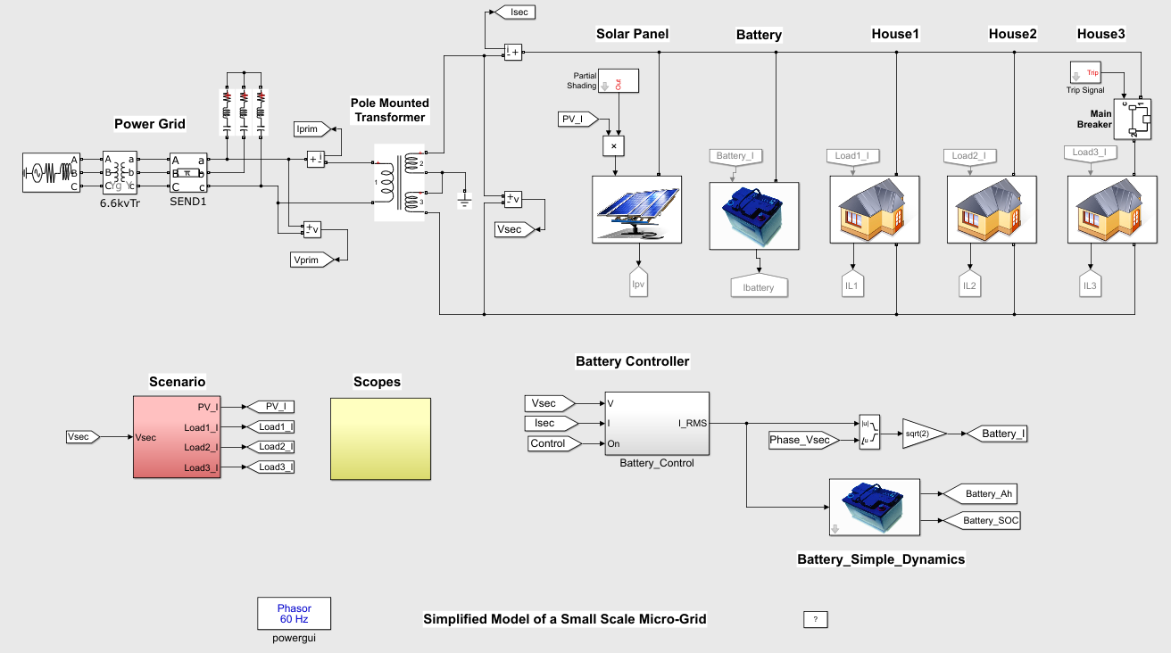
Simplified model of a Small-Scale Microgrid
Sources & Loads :
Solar Power Generation System.
Storage Batteries.
Electricity network.
Loads : 3 houses.
Methodology

Slide 9
Simplified model of a Small-Scale Microgrid
The micro-grid is a single-phase AC network.
The storage battery is controlled by a battery controller.
Three ordinary houses consume energy (maximum of 2.5 kW).
The micro-array is connected to the power network via a transformer.
Methodology

Slide 10
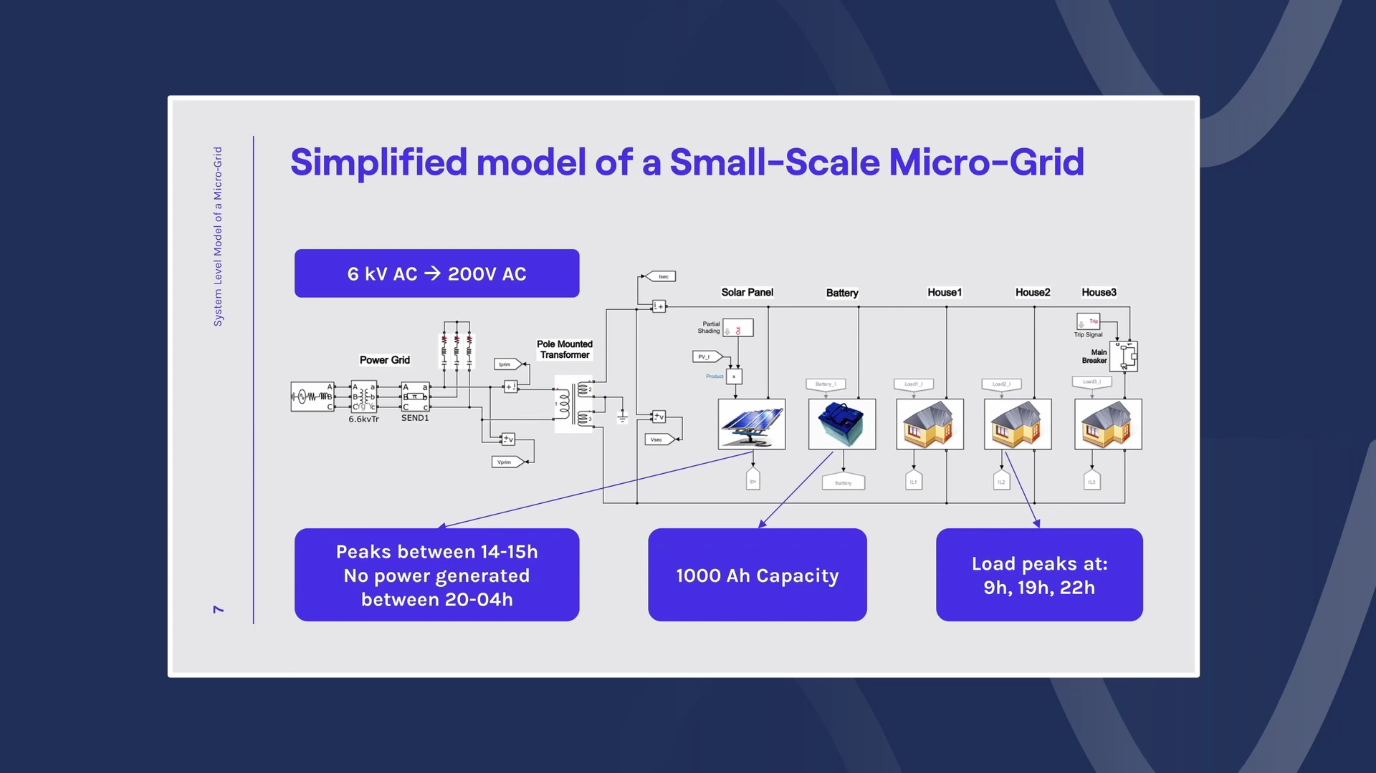
Simplified model of a Small-Scale Microgrid
Methodology

Slide 11
Simulation Results
From 20h to 4h, the solar power generation is 0 W.
The PV generation reaches the peak amount (5 kW) from 14h to 15h.
Loads reaches peak consumption at 9h (6,500 W), 19h, and 22h (7,500 W).
From 0h to 12h and from 18h to 24h, battery control is performed by battery controller.
During the night-time(6 pm-4 am), The PV generation is 0 watt and all
the powers are supplied by the batteries.
Methodology

Slide 12
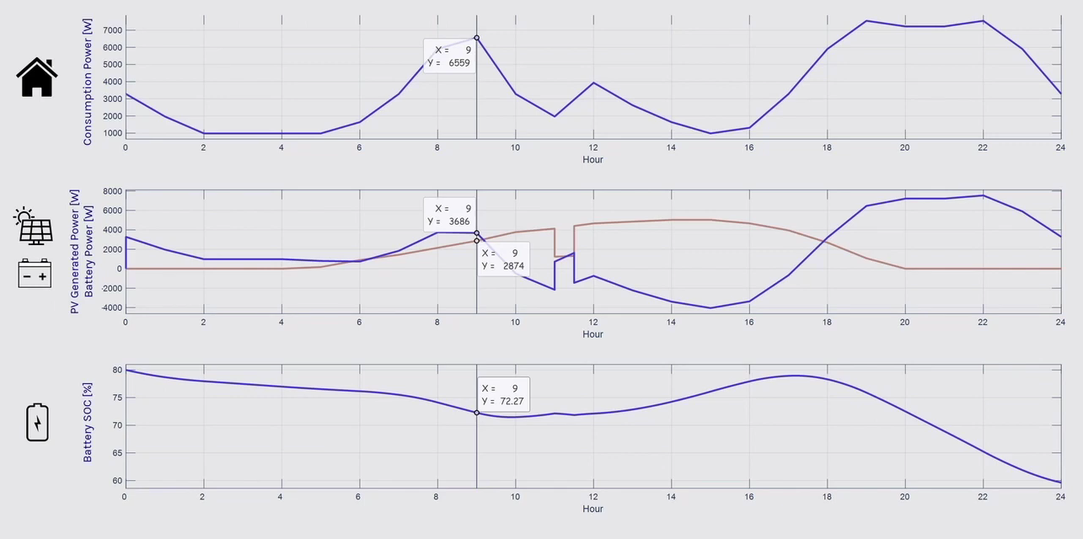
Simulation Results
Methodology

Slide 13
What is Partial Shading
Partial shading in PV (Photovoltaic) solar panels refers to a situation where only a portion of the solar panel's surface is exposed to sunlight while other parts are shaded or receiving less sunlight.
In this model, Partial shading occurs at 11 am for 30 minutes.
Methodology

Slide 14
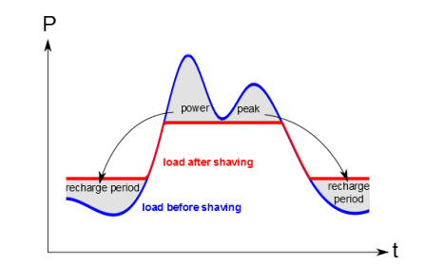
Introduction to Peak shaving
Peak shaving refers to leveling out peak electricity use by power consumers in the industrial and commercial sectors.
Peak shaving reduces the amount of energy purchased from the utility companies during peak energy demand hours.
Methodology

Slide 15
Conclusion
By observing the simulation result we came to a conclusion that if we upgrade the energy storage system ( battery) with the help of super capacitor, the load graph will be flattened.
If we can successfully establish microgrid system, it can facilitate remote applications and allow access to pollution free energy.
Methodology

Slide 16
THANK
YOU!!

